Slide 1









Whiteboardmaths.com
7
2
1
5
© 2004 All rights reserved

Slide 2




Direct Proportion
If two quantities increase at the same rate so that if one is doubled so is the other, then the quantities are said to be directly proportional.
8
In the example shown, if C is the cost of an ice cream and N is the number bought, we write C ∝ N (C is proportional to N).
7
6
If two quantities are directly proportional then their points lie on a straight line from the origin. In our example the equation of this line is C = kN for some value of k. k is called the constant of proportionality and has a value of 1.5 here.
5
Cost (£)
4
Three ice creams cost three times as much as one etc.
3
2
Two ice creams cost twice as much as one.
Eddie’s Ices All £1.50
1
1
2
3
4
5
Number of Ice Creams

Slide 3
Direct Proportion
Terminology
y ∝ x
y varies as x
y varies directly as x
All mean the same thing
y is proportional to x
Strategy for solving proportion problems
1. Find the value of k (the constant of proportionality).
2. Use k together with given values to answer the question.
Example Question 1:
If y is proportional to z and y = 7 when z = 2, find:
(a) the value of y when z = 8 (b) the value of z when y = 10.5
y ∝ z
⇒ y = kz
⇒ k = y/z
k = 7/2 = 3.5
∴ y = 3.5z
(a) y = 3.5 x 8 = 28
(b) z = y/3.5 = 10.5/3.5 = 3

Slide 4
Question 1:
If p is proportional to q and p = 3 when q = 12, find: (a) the value of p when q = 30 (b) the value of q when p = 18
p ∝ q
⇒ p = kq
⇒ k = p/q
k = 3/12
k = 0.25
∴ p = 0.25q
(a) p = 0.25 x 30 = 7.5
(b) q = p/0.25 = 18/0.25 = 72

Slide 5
Example Question 2
Given that y varies as x, fill in the missing values in the table below
x | 3 | 5 | 10 | 20 | 70
y |  |  | 25
7.5
12.5
50
175
From the table k = 25/10 = 2.5.
All x values need to be multiplied by 2.5.
Question 2
Given that y varies as x, fill in the missing values in the table below
x
2
5
10
30
40
y
1.5
3.75
7.5
22.5
30
From the table k = 22.5/30 = 0.75.
All x values need to be multiplied by 0.75.

Slide 6
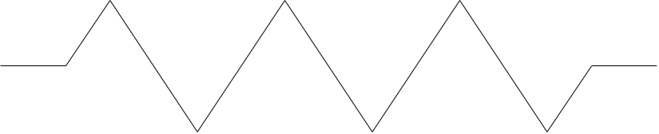
Example Question 3
The Current I in a wire is proportional to the voltage V. If I =12 amps when V = 8 volts find:
(a) The current when the voltage is 15 volts.
(b) The voltage when the current is 7.5 amps.
_
+
I ∝ V
⇒ I = kV
⇒ k = I/V
k = 12/8
k = 1.5
∴ I = 1.5V
(a) I = 1.5 x 15 = 22.5 amps
(b) V = I/1.5 = 7.5/1.5 = 5 volts

Slide 7
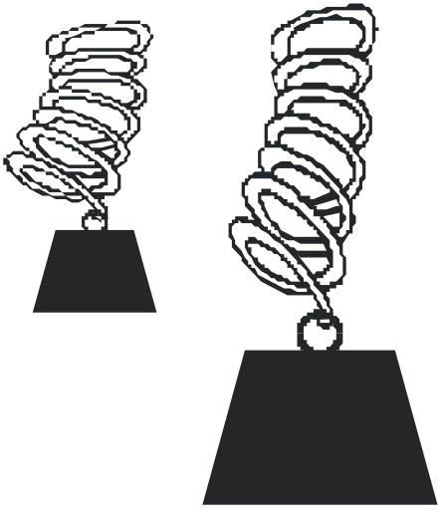
Question 3
A mass M, hangs from the end of a spring. The extension of the spring, E, is proportional to the mass. If a mass of 6 kg produces an extension of 13.5 cm find:
(a) The extension produced by a mass of 5 kg
(b) The mass that produces an extension of 18 cm
E ∝ M
⇒ E = kM
⇒ k = E/M
k = 13.5/6
k = 2.25
∴ E = 2.25 M
(a) E = 2.25 x 5 = 11.25 cm.
(b) M = E/2.25 = 18/2.25 = 8 kg.

Slide 8
Questions Involving Squares and Cubes
One quantity can be proportional to the square or cube of another.
y ∝ x²
y varies as x²
y varies directly as x²
All mean the same thing
y is proportional to x²
y ∝ x³
y varies as x³
y varies directly as x³
All mean the same thing
y is proportional to x³

Slide 9
Questions Involving Squares and Cubes
Example Question 4
Given that y varies directly as x² and If y = 12 when x = 2, calculate:
(a) The value of y when x = 5
(b) The value of x when y = 48
y ∝ x²
⇒ y = kx²
⇒ k = y/x²
k = 12/2² = 3
∴ y = 3x²
(a) y = 3 x 5² = 75
(b) x = √(y/3) = √(48/3) = 4

Slide 10

Questions Involving Squares and Cubes
Question 5
The energy of a moving body E, is proportional to the square of its speed S. If a body has 90 units of energy when it is moving at 3m/s, calculate:
(a) How many units of energy it has at a speed of 8 m/s.
(b) The speed of a body with 810 units of energy.
E ∝ S²
⇒ E = kS²
⇒ k = E/S²
k = 90/3² = 10
∴ E = 10S²
(a) E = 10 x 8² = 640 units
(b) S = √(E/10) = √(810/10) = 9 m/s

Slide 11

Questions Involving Squares and Cubes
Question 6
The value V of a diamond is proportional to the square of its mass M. If a diamond with a mass of 5 g is valued at £100 find:
(a) The value of a diamond with a mass of 20 g.
(b) The mass of a diamond with a value of £2500.
V ∝ M²
⇒ V = kM²
⇒ k = V/M²
k = 100/5² = 4
∴ V = 4M²
(a) V = 4 x 20² = £1600
(b) M = √(V/4) = √(2500/4) = 25 g

Slide 12
Questions Involving Squares and Cubes
Example Question 5
The mass M of a cube is proportional to its side length L. Use the information in the diagram to find:
(a) The mass of the yellow cube.
(b) The side length of the red cube.
M g
320 g
40 g
M ∝ L³
⇒ M = kL³
⇒ k = M/L³
k = 320/4³ = 5
∴ M = 5L³
L cm
4 cm
8 cm
(a) M = 5 x 8³ = 2560 g = 2.56 kg
(b) L = ³√(M/5) = ³√(40/5) = 2 cm

Slide 13



Questions Involving Squares and Cubes
Question 7
The mass M of a sphere is proportional to the cube of its radius r. Use the information in the diagram to find:
(a) The mass of the yellow cube.
(b) The radius of the red cube.
6 cm
r cm
5 cm
140 g
300 g
M g
M ∝ r³
⇒ M = kr³
⇒ k = M/r³
k = 300/5³ = 2.4
∴ M = 2.4r³
(a) M = 2.4 x 6³ = 518.4 g
(b) r = ³√(M/2.4) = ³√(140/2.4) = 3.9 cm (1 dp)

Slide 14
Question 1:
If p is proportional to q and p = 3 when q = 12, find:
the value of p when q = 30
(b) the value of q when p = 18
Example Question 2
Given that y varies as x, fill in the missing values in the table below
x | 3 | 5 | 10 | 20 | 70
y |  |  | 25
Question 2
Given that y varies as x, fill in the missing values in the table below
x
2
5
10
30
40
y
22.5
Example Question 3
The Current I in a wire is proportional to the voltage V.
If I =12 amps when V = 8 volts find:
(a) The current when the voltage is 15 volts.
(b) The voltage when the current is 7.5 amps.
Question 3
A mass M, hangs from the end of a spring.
The extension of the spring, E, is proportional to the mass.
If a mass of 6 kg produces an extension of 13.5 cm find:
(a) The extension produced by a mass of 5 kg
(b) The mass that produces an extension of 18 cm

Slide 15
Example Question 4
Given that y varies directly as x² and If y = 12 when x = 2, calculate:
(a) The value of y when x = 5
(b) The value of x when y = 48
Question 5
The energy of a moving body is E, is proportional to the square of its speed S.
If a body has 90 units of energy when it is moving at 3m/s, calculate:
(a) How many units of energy it has at a speed of 8 m/s
(b) The speed of a body with 810 units of energy.
Question 6
The value V of a diamond is proportional to the square of its mass M.
If a diamond with a mass of 5 g is valued at £100 find:
(a) The value of a diamond with a mass of 20 g.
(b) The mass of a diamond with a value of £2500.

